Slide 1
ChatCSV Powered by AWS Bedrock
Ai-powered Data Analysis For Diamonds

Slide 2
Introduction
What is ChatCSV?
A Streamlit-based AI chatbot integrated with AWS Bedrock.
Enables users to interact with CSV datasets using natural language queries.
Provides insights into diamond inventory, transactions, and quality.

Slide 3
Key Features
AI-powered Query Processing (AWS Bedrock - Claude v2)
Real-time Data Insights & Comparisons
Interactive Chat & CSV Data Viewing
Diamond Inventory & Transaction Analysis
Efficiency Metrics & Business Intelligence

Slide 4
Technology Stack
Frontend: Streamlit for UI
Backend: Python & Pandas for Data Handling
AI Model: AWS Bedrock - Claude v2
Cloud Storage & Security: AWS (Bedrock, Boto3)
Environment Management: dotenv for Secure Credential Handling

Slide 5
How It Works
User Uploads a CSV File
System Reads & Displays Sample Data
User Inputs a Query
AI Analyzes & Responds
Response Includes Insights & Trends
Tabular Summaries for Better Understanding

Slide 6
Application Flow
File Upload: User uploads diamond-related datasets.
Data Processing: System extracts relevant details.
Query Handling: User inputs a question.
AI Response: AWS Bedrock processes and returns insightful results.
Visualization & Insights: Data is displayed in a structured format.

Slide 7
Efficiency Metrics Computation
Total Issue Carats: Sum of all issued carats per quarter.
Average Processing Time Per Stone: Mean Time Diff for transactions.
Loss Percentage: (Loss Cts / Issue Carats) * 100.
Return Efficiency: (Return Cts / Issue Carats) * 100.

Slide 8
Dataset Information
Key Columns:
SEQNO, SUB_SEQNO, FORM_NAME, COID, BRID, LOTNO, STONE_ID, PROCESS, TRANS. DATE, PCS, CTS, RET CTS, LOSS CTS, FROM ENTITY, TO ENTITY, ENTRY DATE, SALES NO, DIAMOND TYPE, CUT, POLISH, SYMM, FLOUR, COLOR, SHP, etc.
1. Sample_AI_diamond.csv
Description: This dataset contains AI-processed information regarding individual diamond stones, tracking their transactions, quality parameters, and inventory status.

Slide 9
Key Columns:
Lotno, Pkt, Dept, Pktno, Item, Org Pcs, Issue Carats, F Issue Days, Return Cts, Loss Cts, Exp Pol, Value, Shape, Cut, Purity, Color, Polish, Symmetry, Fr Entity Type, To Entity, Trans Date, Transaction Time, Droid, Rfid, etc.
2. Transactional_diamond.csv
Description: This dataset captures transactional details of diamonds, tracking their movement across different processing entities and recording inventory metrics.

Slide 10
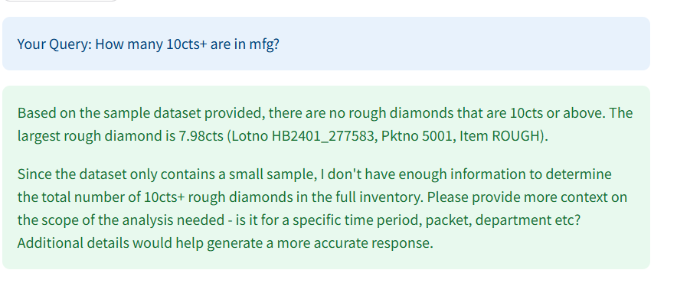
Example Query & Response

Slide 11
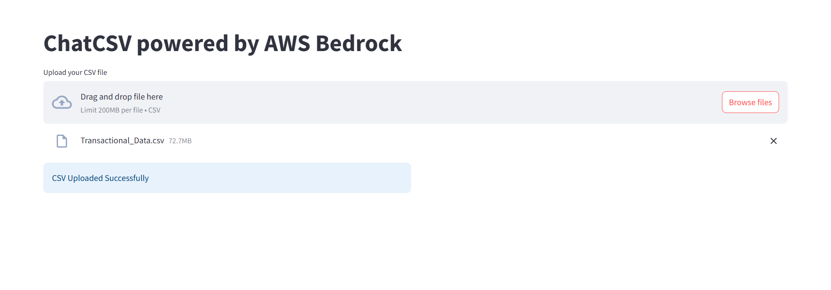
Live Demonstration
Step 1: Upload CSV file

Slide 12
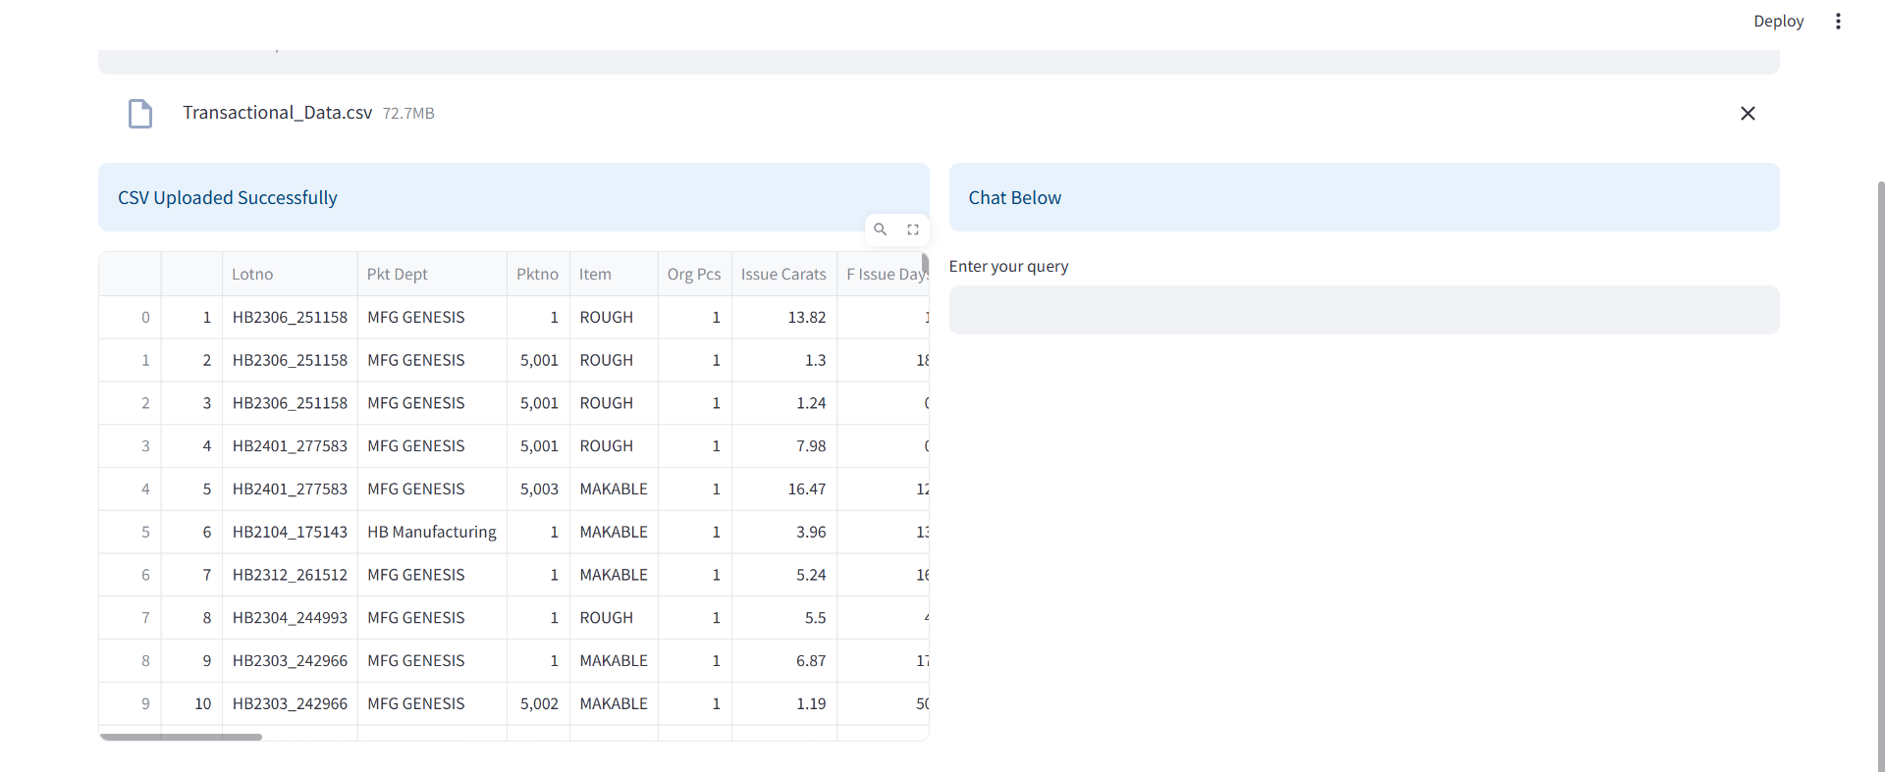
Step 2: View the sample dataset

Slide 13
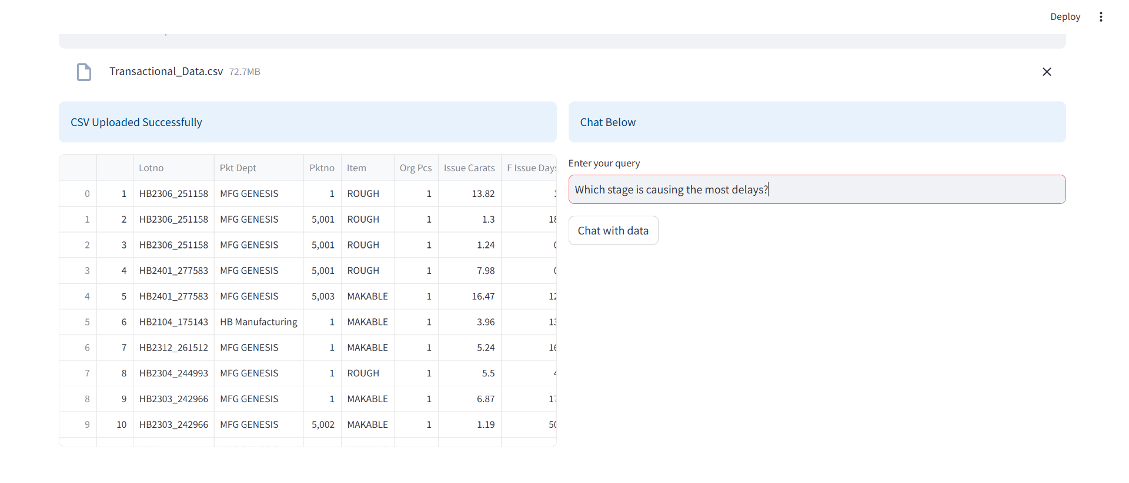
Step 3: Enter a query

Slide 14
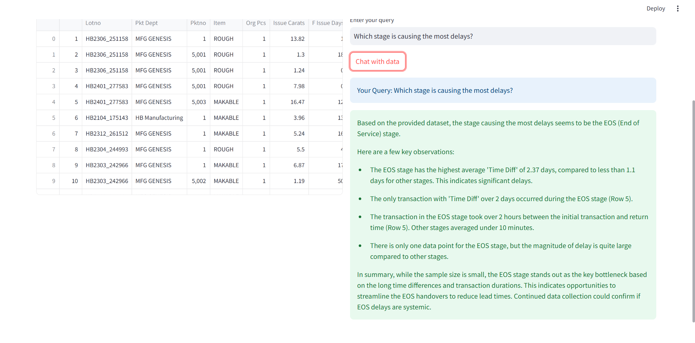
Step 4: Observe AI-powered responses & insights

Slide 15
Benefits & Business Value
Automated Data Analysis
Real-time Decision Making
Historical Trend Comparisons
Operational Efficiency Monitoring
Business Intelligence for Diamond Supply Chain

Slide 16
Future Enhancements
Integration with Real-time Databases
Advanced Visualization Dashboards
Enhanced AI with Predictive Insights
Multilingual Support for Global Users

